Slide 1
TFSS-Techno Functional Soft Skills
Time Management
Goal Setting
Reverse Planning
Mile Stones
Accountability
Responsible, Accountable, Consulted and Informed (RACI) model

Slide 2
Time Management
TM is the ability to plan and control how you spend your available time to effectively accomplish your goals
Its the collective name for everything that's related to work habits, instruments, and techniques that help you use your time as effectively as possible.
TM is a skill that can be improved
why is TM important:
Good TM skills do the following:
-Help you achieve your goals faster.
-Provide the ability to do more with less time
-Help you achieve balance b/w work and your private life
The most important question of tm is which goal to pursue.
-What is your goal?
-Which activities do you undertake everyday to get there?

Slide 3
Time Management
Essential skills for TM are,
-Setting goals
-Prioritizing tasks
-Planning
-Organizing
Example Strategies:
-Using a task list to track the tasks that you need to do
-Minimize distraction(for ex, putting your phone away)
-Minimizing interruption or finding a quite space to work
-Limiting Multi-Tasking
-Understanding priorities

Slide 4
Time Management Strategy
Examples of TMS include:
-Managing your email messages by responding to them only at the start and end of the your day
-Using an agenda for meetings
What other TMS do you know?
Prioritize wisely. Importance of task rather urgency.
-Important and urgent: These tasks have important deadlines with high urgency—complete them right away.
Important but not urgent: These items are important but don’t require immediate action and should involve long-term development strategizing. Strive to spend most of your time in this quadrant.
Urgent but not important: These tasks are urgent but not important. Minimize, delegate, or eliminate them because they don’t contribute to your output. They are generally distractions that may result from the poor planning of others.
Not urgent and not important: These activities hold little if any value and should be eliminated as much as possible.
DO, Decide, Delegate and Delete task
Assign time limits to tasks.

Slide 5
TMS Activity
Page-7
Activity: write down 2 TMS you can start using your professional life
-explain why you believe that these strategies' will be helpful
1. Figure out how we’re currently spending your time.
2. Create a daily schedule—and stick with it.
3. Prioritize wisely.
4. Group similar tasks together.
5. Avoid the urge to multitask.
6. Assign time limits to tasks.
7. Build in buffers.
8. Learn to say no.
9. Get organized.
10. Eliminate distractions.

Slide 6
TMS Activity
The Harvard Business Review identifies three primary skills that separate time management success from failure:
Awareness: thinking realistically about your time by understanding it is a limited resource.
Arrangement: organizing goals, plans, schedules, and tasks to most effectively use your time.
Adaptation: regularly monitoring how you use your time while performing activities, including adjusting to interruptions or changing priorities.
These time management strategies are adequate to keep your productivity up and make sure you do all the things you need to do in time, efficiently and effectively.

Slide 7
Goal Setting
goal setting is a process of thinking about your idea future and motivating your self to acheive your goals

Slide 8
Reverse Planning
RP is planning by starting with your end goal and then working backward to develop a plan of action.
RP is a TMS
RP or backward PLANNING IS THE OPPOSITE OF FORWARD PLANNING
begin with the final goal or end state, and identify which action you must do immediately before the final step to acheive it.
Then continue to identify each milestone, or key activity and work backward until you reach the starting point.
Ex: painting a room
Suppose that you want to repaint your interior walls. your goal might be four perfectly painted living room walls. if you open a can of paint and start applying it to the walls without a plan, you might not achieve the desired result
you plan in reverse, your plan might look like this list:
8: Remove the tape from the walls
7.let the paint dry.
6.Apply the paint
5Let the primer dry
4 apply the primer
3 cover the light switches and adjacent surfaces with tape.
2 lay down a cloth to protect the floor
1 cover or store your furniture.

Slide 9
Reverse Planning
Design a plan with backward planning: Consider a learning goal that’s based on the AWS re/start training.
for example:
you could explore a subject that you already learned about to deepen your understanding.
You could also consider a technical goal that you want to acheive.
Page11 Activity:
set a learning goal ex: I can configure a private N/W
working backward from the goal to your starting point, identify the series of milestones that you must complete.
Plan your network. Plan your network. Firewall: Routers, VPN, Server, Switches and hubs, Computers, Lines
Create an address plan Class full n/w ,Hist or CIDR
Assign the devices to a network
Choose a network host range
Assign a host addresses to each computer
Write down the subnet mask near the network address
Connect your network

Slide 10
Milestones
MS are specific, important points along a project timeline. These mile stones form a sequence of events that lead to the achievement of your goal

Slide 11
Accountability
Accountability is the responsibility of a person to complete their assigned tasks and be answerable for their actions
Taking ownership
ex: We were assigned a task.
We take responsibility to complete the task.
Unfortunately, because of poor planning the result of your efforts won't meet the expectations of your supervisor.
You decide to admit your errors(poor plan) to your supervisor
you might have a team member whom u can't rely on for help, or you might be forced to handle a team member's unfinished tasks. in these cases, the underlying problem is often a lack of accountability.
when you are given a task and you will bear the responsibility if it goes wrong, you are said to be accountability for the task
illustrating accountability:
.when someone on your team admits that they made an error, they are showing accountability
.You can show Accountability in the following ways:
-Communicate your goals
-Be honest about your capabilities
-keep your commitments
-admit your mistakes

Slide 12
Demonstrating Accountability
Demonstrating accountability:
We can Demonstrate accountability in professional environment in several ways including the following:
-Being on time
-Communicating your progress on your assignments and any issues that you might have
-asking for feedback on your work
Page 15 Activity: research ways to demonstrate accountability
-make at least 5 ways that you can demonstrate accountability.
1
2
3
4
5

Slide 13
Demonstrating Accountability
Admit wrongdoings: Perhaps the most obvious way to hold yourself accountable is to admit when you’re wrong or have made a mistake; there is much to be said for someone who is willing to do so. It’s memorable when people will accept responsibility, but it’s equally memorable when someone seems to seldom apologize.
Take pride in your work: Since you are responsible for the work that you complete, it’s important to give it your all. Even if a task seems simple or mundane, you want to show that you are responsible for the effort put into your assignments and you hold yourself to a high standard.
Don’t make excuses: There’s a difference between an excuse and a valid reason. Generally, the difference between the two is clear. If you’re going to be accountable for yourself, your actions, and your work, you must be truthful, not only with those you work with, but to yourself. Sometimes it can be more difficult to be honest with yourself, but the key to being authentic often starts with being true to yourself, and you’ll find that it then comes naturally to be honest with others.
Be transparent: If you’re struggling with a task, ask for help. If you don’t think you’ll be able to meet your deadline, let your supervisor know. People appreciate when others are upfront about issues of these sorts.
Contribute: When you work for a company, part of your job is to represent that company well. There are ways of contributing to your company that go beyond doing your job. It might not be absolutely necessary for you to raise your hand in a meeting and contribute, but it’s a good idea to be as involved as you can. Having solid suggestions to bring to the table will show that you are giving your job your all.
Be upfront: Your issues at work are your responsibilities, thus avoiding them is avoiding your responsibilities. If you have a problem, whether that be with the software you’re using, the people on your team, or being on time to work, address it! Doing nothing about your concerns also does nothing to alleviate them. Tackling them head on will show that you are taking responsibility for whatever comes your way—even unfavorable circumstances and situations.

Slide 14
RACI
The RACI model is tool to clarify roles and responsibilities with in project teams. RACI stands for....
Scenario:
Imagine that you are a junir engineer. In your work you take on more respo than you can handle. This siutation might mean that you have too many tasks to work on or that you took on tasks that are outside your role. As a result you might be experience a very large workload
it can be useful to discuss the responsibilities on your team with your colleagues and your mgr by using RACI matrix
Page 18
Activity: learn each category abt RACI chart
describe diff b.w R and A
Describe the diff b/w C and I
-Can one person's name appear in more than one category? why or why not?

Slide 15
The cells inside the RACI model or chart are filled in based on the following criteria – R = Responsible = The person who performs the work. There must be one “R” on every row, no more and no less. “R” is the only letter that must appear in each row. A = Accountable = The person ultimately accountable for the work or decision being made. Use this letter where appropriate, but not to excess – only when a key decision or task is at hand.
RACI\RAS(Supportive)CI-alternative is Fresco
Trello-prodi
https://www.consuunt.com/raci-matrix/

Slide 16
RACI
Not having project roles and responsibilities set in place leads to a myriad of project management-related issues—schedule delays, scaling costs, and lower performance, just to name a few.
That’s when the RACI matrix, also known as the RACI diagram or responsibility assignment matrix, comes into the picture.
The RACI model helps with mapping all of the stakeholders’ roles and responsibilities, bringing structure and clarity, and engaging everyone from the team in the successful project delivery so that miscalculations are out of the question.
Here’s why many people from the corporate world across various industries, from healthcare to construction, swear by RACI charts.
Responsible: As you can already suggest, this person is responsible for taking action and ensuring that tasks on the project are being worked on.
Typically, this is a team member or a project manager that reports to an A. You can have more Rs in a RACI, and some of them can also be involved in the decision-making process.
However, it is highly advisable not to blow things up out of proportion and over-assign the number of Responsibles in your responsibility assignment matrix.

Slide 17
RACI
Responsible: As you can already suggest, this person is responsible for taking action and ensuring that tasks on the project are being worked on.
Typically, this is a team member or a project manager that reports to an A. You can have more Rs in a RACI, and some of them can also be involved in the decision-making process.
However, it is highly advisable not to blow things up out of proportion and over-assign the number of Responsible in your responsibility assignment matrix.
Accountable: That’s someone who ensures all the responsibilities are assigned properly, approves or rejects work or decisions (basically, this person is a decision maker), and ensures that everything is successfully and timely delivered. According to the RACI matrix, there should be only one A.
Consulted: This is the person the team consults about various topics and actions, an expert. This person, or multiple persons, provides feedback and evaluates so tasks can be performed.
Informed: Someone who should be updated on progress once everything is done and dusted but isn’t directly involved in the process. This person doesn’t contribute to making decisions or delivering tasks nor is consulted on any matter.
We know project management teams love abbreviations: PMP, KPI, SOW, and SME. The list goes on and on, but the RACI matrix chart makes it a breeze to scheme out key decisions, tasks, milestones, and roles.

Slide 18
Adv RACI
It eliminates role confusion and confusion about who makes decisions (it could be that the Accountable or Responsible party is the decision-maker, so it should be made clear from the beginning)
It encourages teamwork and communication between everyone involved in the project, which leads to setting expectations straight
It prevents over and under-allocation of resources of a team member and ensures a smooth reallocation of resources when needed
It can guarantee that even in case of resource reallocation, no task is overlooked
By using it, you’ll streamline communications, eliminate conflict resolution, instill trust and ensure a high level of engagement

Slide 19
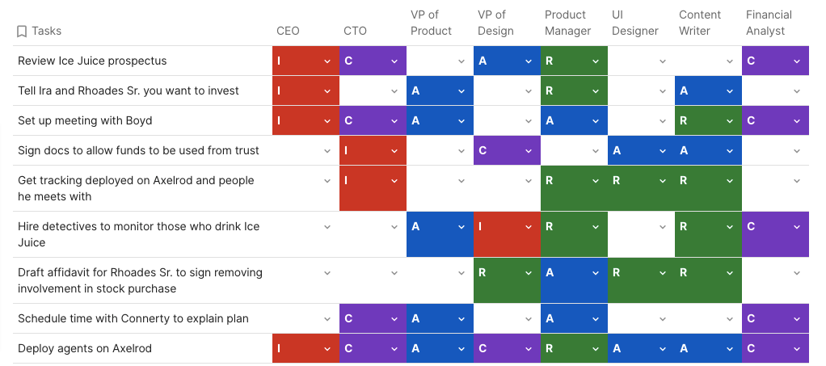
RACI Matrix in tasks

